Slide 1
Open Source:
A Recipe for Success
John Mone
Endurance International Group

Slide 2








Paths of Success for Open Source
Internet
Web Hosting
Pure Plays

Slide 3
enable
Open Source
Small Business
Economy
drive

Slide 4
enable
Open Source
Small Business
Economy
feedback
drive

Slide 5
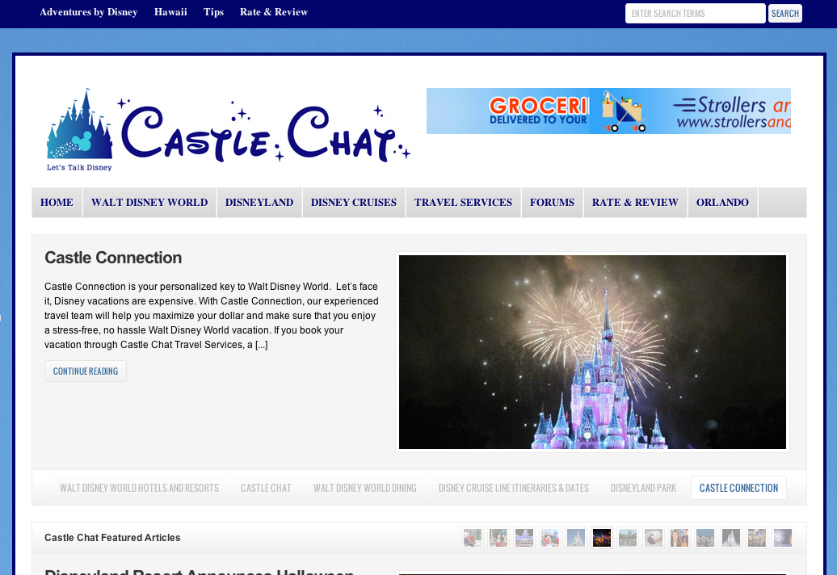








Slide 6

Startup Costs
2000
50mb Hosting Account $20/mo.
Shopping Cart $1,000
SQL Server License $1,800
Email Accounts $1,500
2012
Bluehost Hosting Account ~$5/mo.
Open source tools Free
One-click installation Free
Today, users get all the solutions they need and reliable web hosting for the cost of a latte per month.

Slide 7



Insights
70% of Customers
Identify themselves
as SMB.
1 in 5 SMBs …
Generates over half of their revenue from their site
The Long Tail
85% earn Less than $50k from their site

Slide 8

Bluehost Open Source Solutions
A Commitment to Help Projects
A Commitment to Enhance Exposure
Project funding
Full-time Bluehost resources
Direct feedback from user community
Educating & informing user communities
Helping projects to grow and scale
Exposure to our customer base
Utilization of one-click installer tools
Unique landing pages promoting projects
Our participation in project forums
Learn more at: bluehost.com/boss
Download the O’Reilly Paper: bluehost.com/opensource
bluehost open source solutions

